Slide 1

Team Zero
Renting a Room of One’s Own: Analyzing Airbnb Listings in DC and the Factors Fetching Top Prices
Airbnb
Georgetown SCS Data Science Program
Cohort 6 - Summer 2016
Devin, Domenico, & Brittany

Slide 2
What is Airbnb?
Airbnb is an online marketplace connecting travelers with local hosts.
Hosts list their available space and earn extra income.
Travelers book unique home stays and get to interact with locals, often for less than the price of a hotel.
Founded August 2008 in San Francisco, CA.
21 offices worldwide; 2,000+ associates.

Slide 3
Metrics
Company valuation $30B (August 2016).
Present in 34,000+ cities across 190+ countries.
Over 1.2M listings and 35M guests served.
More than 140K people stay at Airbnb listings daily.

Slide 4
Practical Matters
Airbnb provides:
The listing , booking, and payment platform.
Insurance.
Hosts set their own prices.
Airbnb collects commissions from:
Host: Airbnb gets 10% of every booking from the property lister.
Traveler: And a 3% commission from the property booker.

Slide 5
What if a host needs additional guidance?

Slide 6
We hypothesize that listing price is determined by certain key features, which can be identified, and which may or may not be under the host’s control.
Further, we suspect that the listings that fetch the highest prices and occupancy rates are probably:
In good locations (e.g., close to Metro or walking distance to attractions)
Good values (e.g., they have good price to occupancy ratios)
Posted by hosts that get strong reviews
Our aim is to explore and analyze our data to provide enhanced, granular insight into Airbnb listings in DC and the characteristics that have the greatest impact on price.
This enhanced understanding would allow current and potential hosts to better price their listings in this market.

Slide 7
About our data
Instances: Airbnb listings
Snapshot scrape of Airbnb listing data for Washington, DC as of October 2015
From: InsideAirbnb.com
Four CSVs, one GeoJSON
3,724 rows and 92 columns (43 of which we deemed relevant enough for further exploration)
Licensed under Creative Commons
Notes:
The data is key, of course.

Slide 8
Methodology

Slide 9
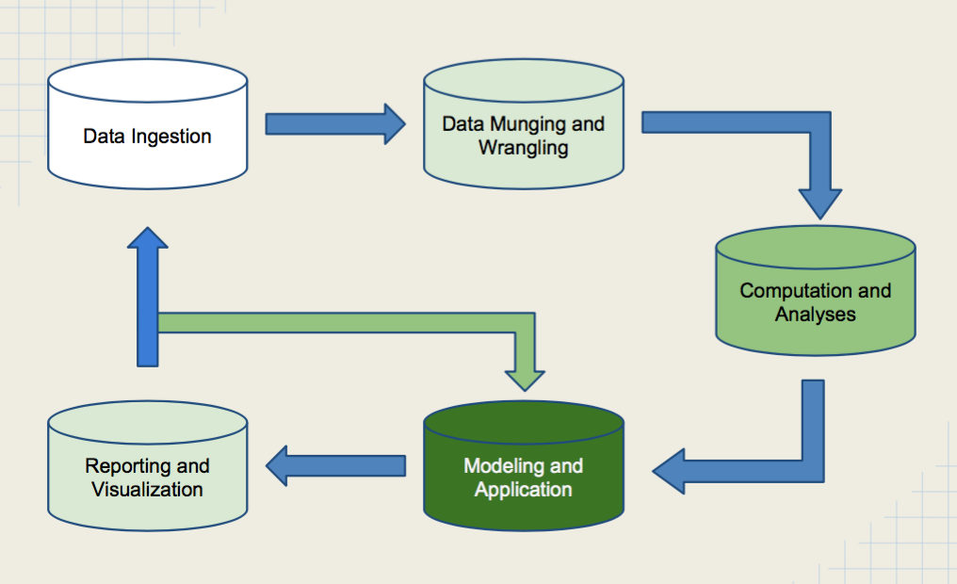

Slide 10

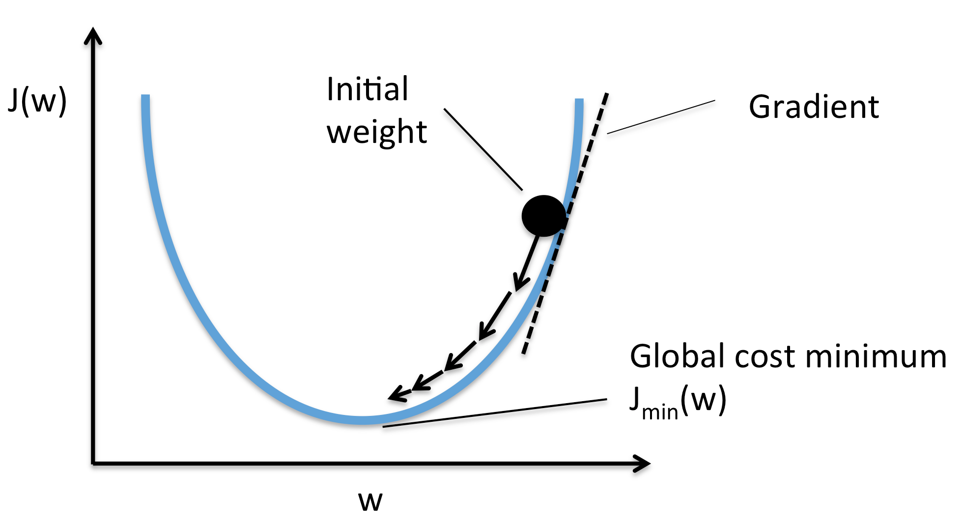
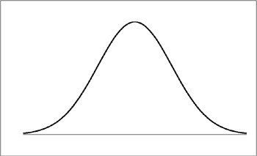







Data source: www.insideairbnb.com
(derived from www.airbnb.com)
Format:
.csv, GeoJSON
Size:
Up to 1M rows
Up to 92 columns
Modeling + Application:
Attempt to predict optimal pricing scheme based on neighborhood to minimize vacancy
Capstone Bonus!
Higher level analysis with Pandas/Numpy/other
?.py
No icon here
?.py
Solution:
Statistics module for basic validation
?.py
Reporting + Visualization:
Attempt to replicate visualization using Tableau OR Mapbox
listingstats.py
?.py
Optional:
Attempt to layer Metro data to optimize for distance from Metro station
Computation + Analysis Problem: How do we verify we didn’t corrupt our data during ingest or munging/wrangling?
Ingest
Problem:
Files too large for Excel
Munge + Wrangle Problem: Neighborhood coordinates are separate from listing file
dbingest.py
?.py
Solution 1: Manipulate files directly using csv and Pandas modules
Solution 2: Load csv data into a local PostgreSQL or MySQL database --
use Pyscopg or MySQLdb modules
Solution: Neighborhood column keys listing data to GeoJSON neighborhood feature

Slide 11
Exploring the Data

Slide 12
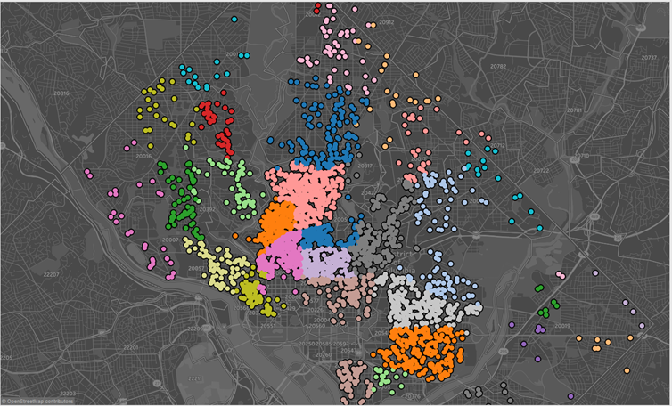
Data.Describe()
3,273 Listings
92 Features
39 Neighborhoods
- 61% Apartments
- 33% House
- 2% Condo
- 4% Other
65% Entire Home/ Apt
32% Private Room
3% Shared Room
Notes:
95% of the listings have a bed vs the remainder being a Futon, pullout sofa, air mattress, etc..
83% of the listings accommodate 1- 4 people with the majority being 2 and al listings included 1 bathroom

Slide 13
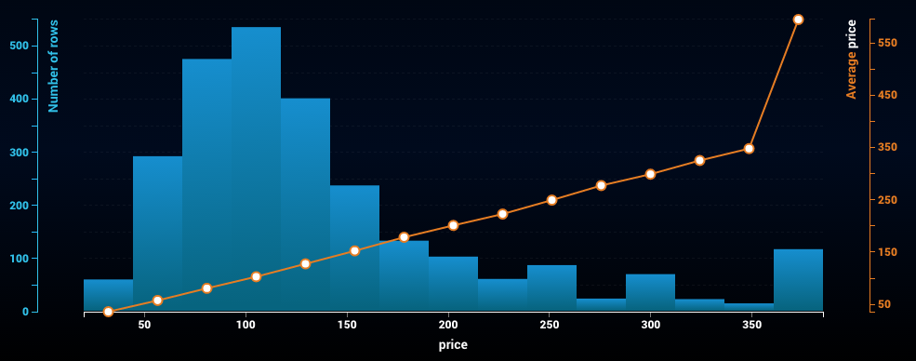
Price:
Mean $147
Std Dev $134
Median $115
Max $2,822
Min $20
Positive skew distribution

Slide 14
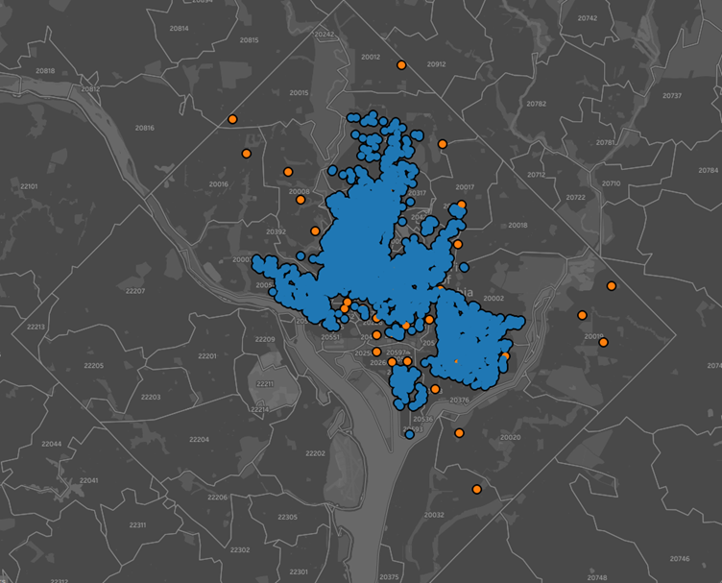
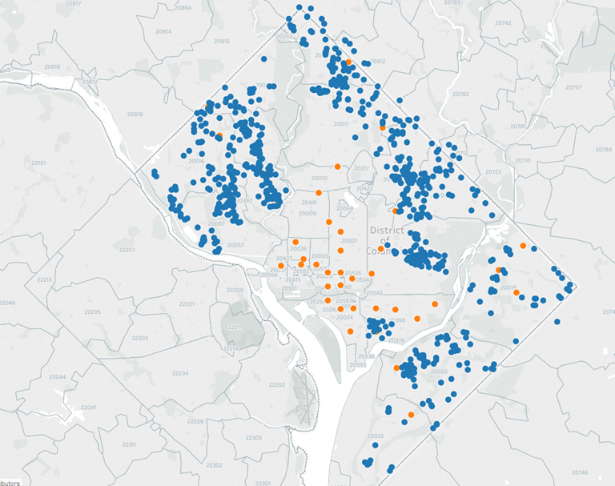
80/20 & Metro
Avg Dist to Metro <.5 mi.
Range: 0.01 - 2.31 mi.
Median Price:
<264 ft. $135
>1.5 mi. $99
80% in 13 of 39 Neighborhoods

Slide 15
Feature Engineering & Selection

Slide 16
Target
Price

Slide 17
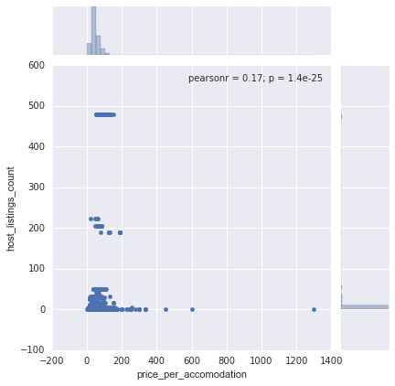
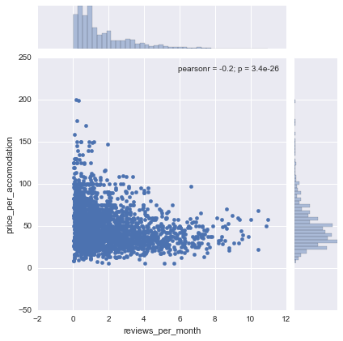
Why Feature Selection is Important

Slide 18
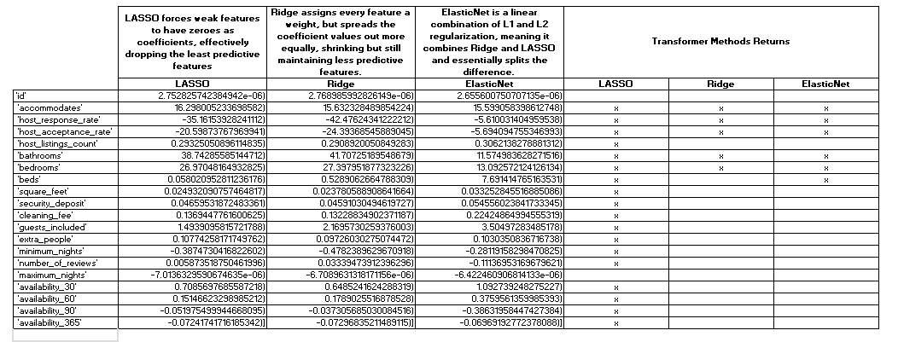
Feature selection

Slide 19
Computation, Analysis, & Modeling

Slide 20
What type of problem is this?
What sort of model are we going to use?
Regression
Let’s find out

Slide 21
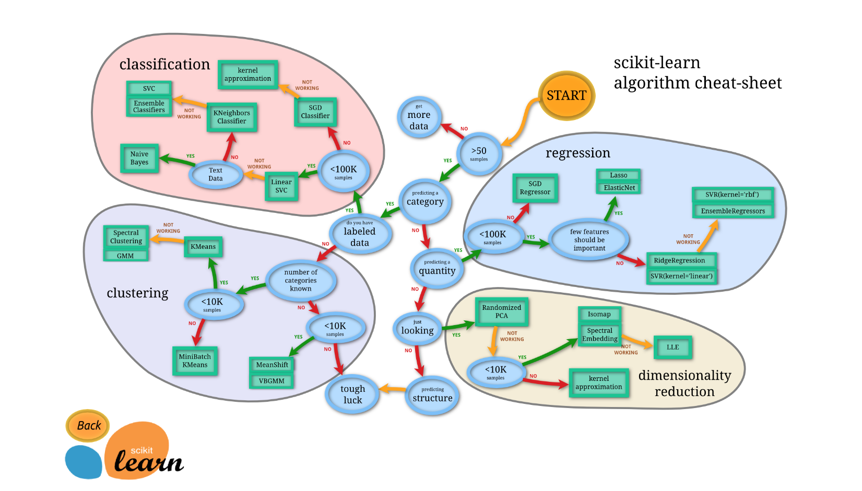
?

Slide 22
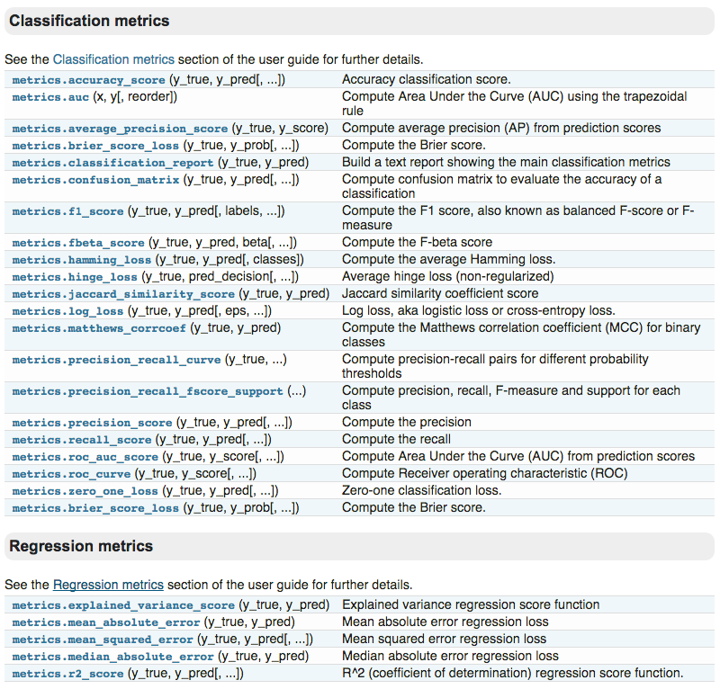
RTFM

Slide 23
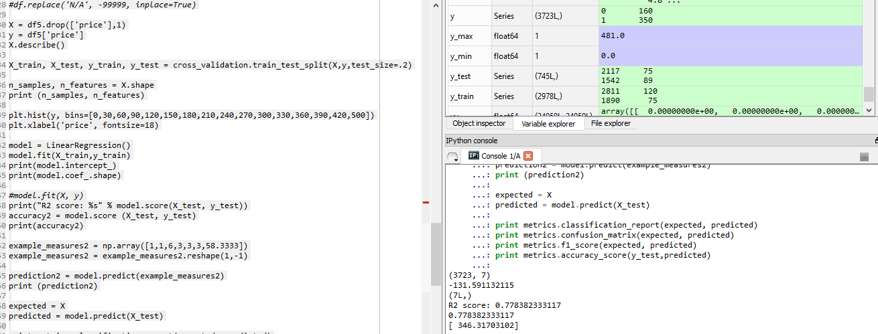
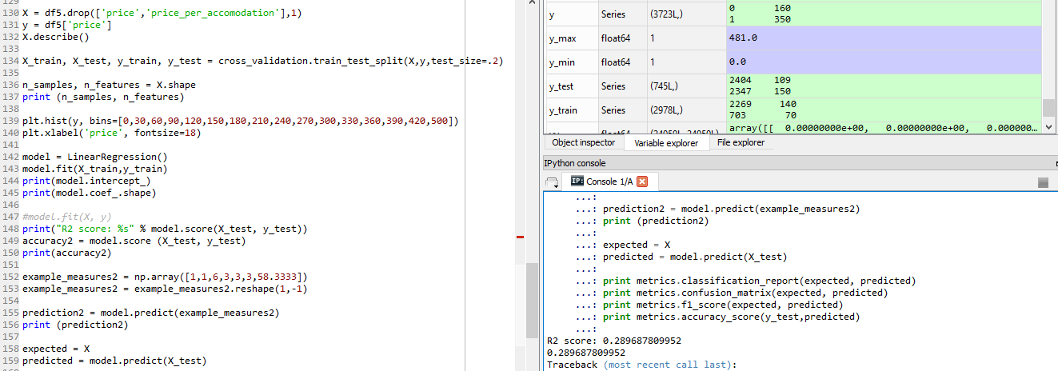

Slide 24
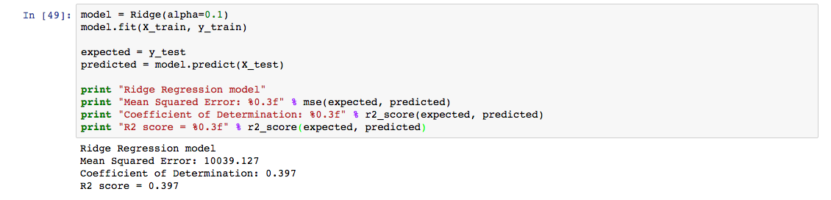
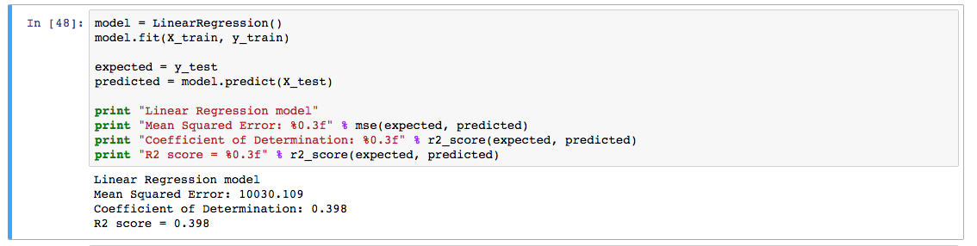
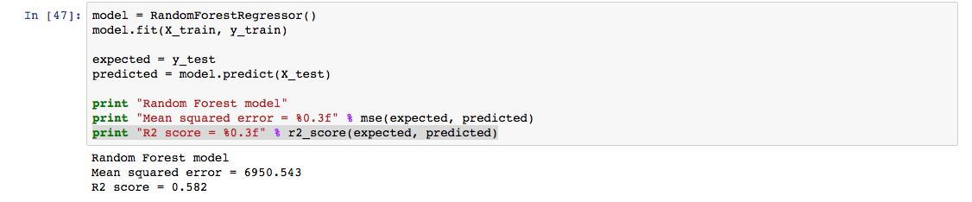

Slide 25
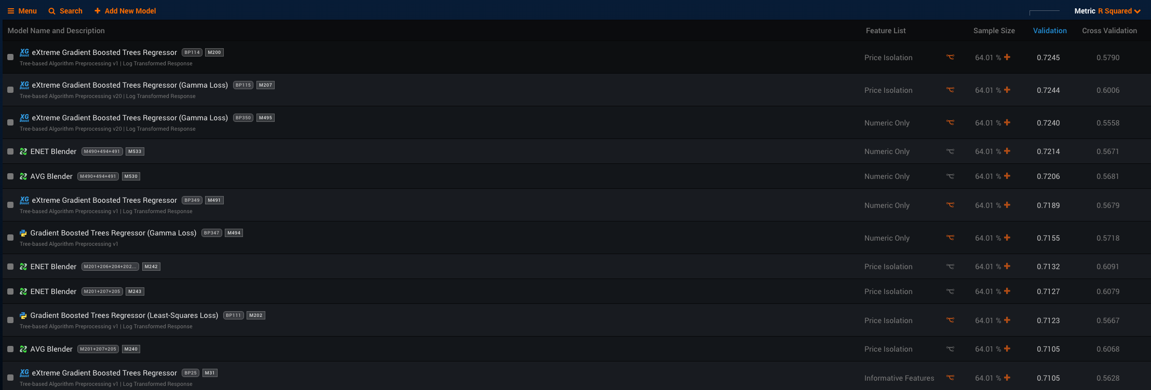
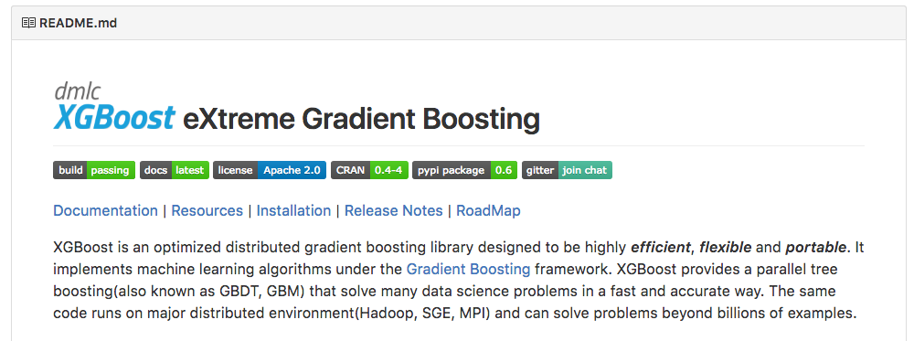
This might be bad. Did we pick the wrong features?

Slide 26
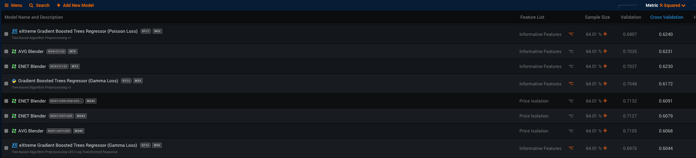
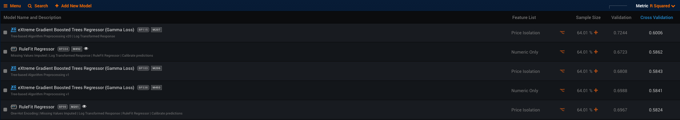
Better? But now we are including weekly and monthly price, which is bad.
What the heck?
“In mathematical optimization, statistics, decision theory and machine learning, a loss function or cost function is a function that maps an event or values of one or more variables onto a real number intuitively representing some "cost" associated with the event."
https://en.wikipedia.org/wiki/Loss_function
This looks pretty good. We think.

Slide 27
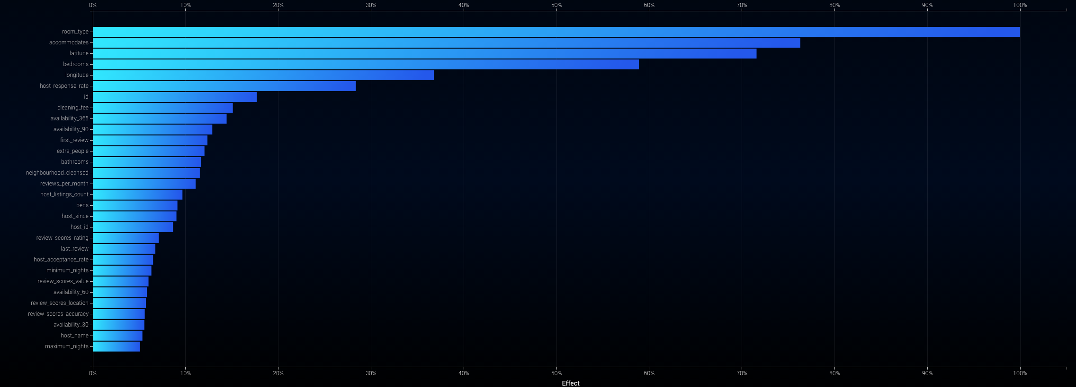
Suspicious. But hard to tell.

Slide 28
Conclusions and next steps

Slide 29
Key findings
Many of the things you would expect to affect price DO in this case, but other things matter as well.
Unsurprisingly, people care about the number of beds and the value of a listing (cost per person vs. overall cost).
Host responsiveness to messages also emerged as a key factor -- don’t be a stranger!
Price skew might support the hypothesis that Airbnb guests have certain price ceilings, perhaps due to income but also perhaps due to brand perceptions and expectations.
Regression modeling assisted with predicting price and guiding hosts to key features within their control.
Further research will need to be conducted on which model leads to higher occupancy rates.

Slide 30
Areas for future exploration
Other ideas and next steps:
Further refine our machine learning models.
Test DC findings against other city data.
Incorporate additional data sources to explore the relationship between listing prices and factors like:
Crime rates
Real estate prices (Zillow)
Proximity to restaurants
Identify potential investment location based on features listed above.
PROFIT!
Better familiarity with visualizations using Seaborn, Tableau, Mapbox, Matplotlib to tease out improved geographic understanding.

Slide 31







Tools

Slide 32
Thank you!

Slide 33
Backup Slides

Slide 34
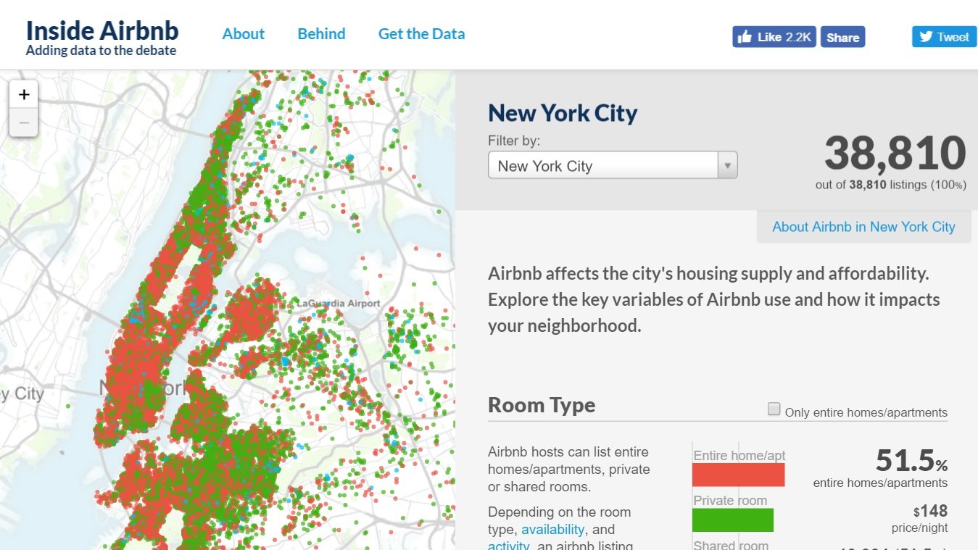

Slide 35
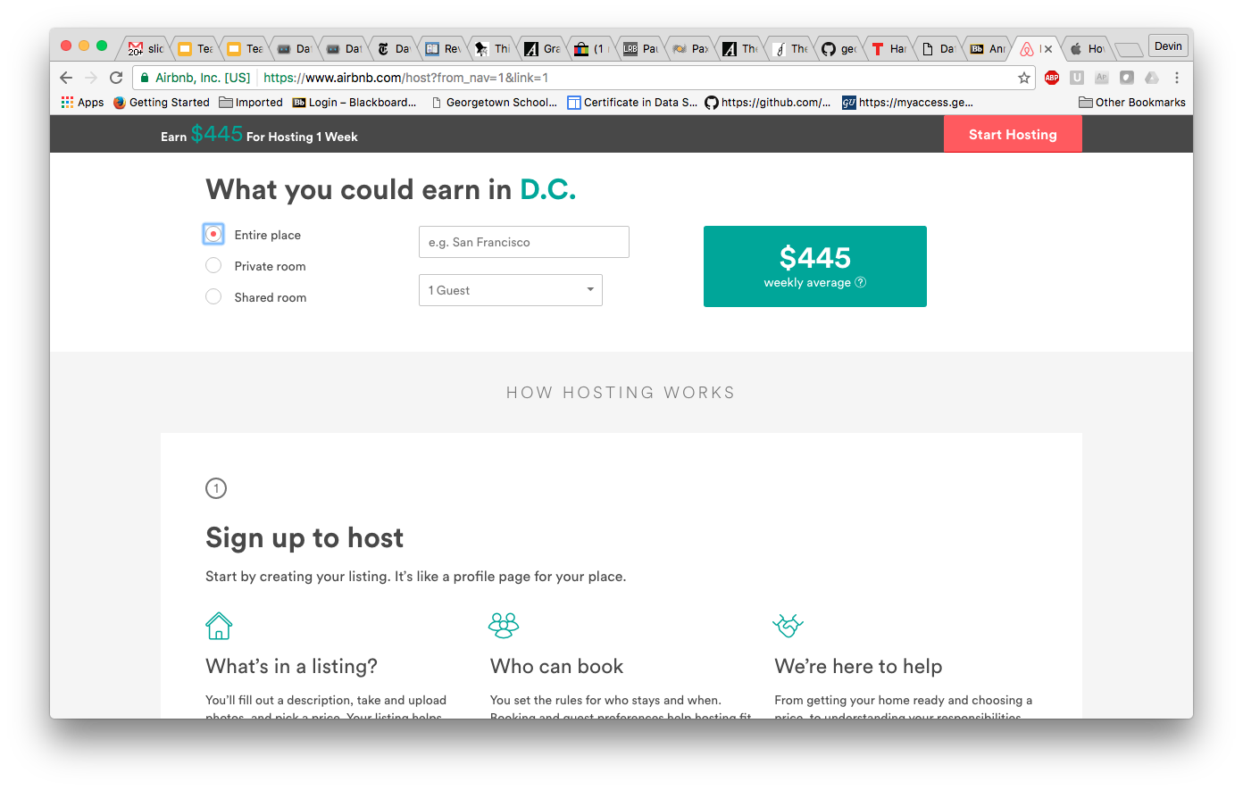
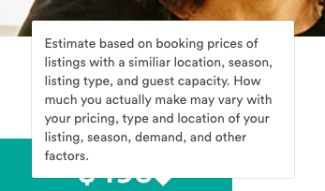

Slide 36
Project milestones
Identified and secured dataset, loaded it into a local PostgreSQL database
Connected and configured Team Zero GitHub repo
Successfully performed initial master commit (little victories)
Created feature branch for data ingestion script
Implemented feature branch workflow roughly aligned with our architecture
Created two working branches for data ingest and statistical modeling
Explored data ingest by implementing two ingest pathways, per architecture: direct from source CSVs and a CSV → locally hosted PostgreSQL database pathway
Began initial stats modeling efforts, including confirmation of successful ingest through basic stats modeling
More exploratory research in Pandas as well as plotting.scatter_matrix and matplotlib
Began initial data visualization efforts, principally focused on mapping the listings data
Developed an early working Tableau map and a mockup of desired final product
Testing and selection of machine learning models to predict optimal price based on key parameters (e.g., geography)
Finalized stats code to facilitate data exploration and sanity checks via visualizations
Implemented machine learning models
Developed more mature data visualizations

